Slide 1



Global Tuberculosis Trends Analysis and Predictions
HAP-780
Presentation by Krutika DEshmukh

Slide 2

Introduction to Tuberculosis
Every year, 10 million people fall ill with tuberculosis (TB). Despite being a preventable and curable disease, 1.5 million people die from TB each year – making it the world’s top infectious killer
People infected with TB bacteria have a 5–10% lifetime risk of falling ill with TB. Those with compromised immune systems, such as people living with HIV, malnutrition or diabetes, or people who use tobacco, have a higher risk of falling ill.
Most of the people who fall ill with TB live in low- and middle-income countries, but TB is present all over the world

Slide 3

To create a more detailed and in-depth analysis that stands out, we can focus on a few key areas:
Data Exploration and Cleaning: Before diving into analysis, we need to thoroughly explore and clean the data, ensuring it is ready for meaningful analysis.
Descriptive Analysis: Understand the overall trends, distributions, and relationships within the data.
Comparative and Correlational Analysis: Identify correlations and compare different factors, such as incidence rates across regions and age groups, treatment success rates, and the impact of HIV on tuberculosis outcomes.
Predictive Modeling and Classification: Develop predictive models to forecast future trends or classify data points, such as identifying countries at risk of high tuberculosis incidence.
Detailed Insights and Recommendations: Provide actionable insights that can inform public health policies or interventions.

Slide 4
DATA Exploration And Cleaning:
Removing Duplicates from the Data
Removing the nulls from the Data
Joining the 5 tables which have information like Country Name: Entity , Country Code , Incidence Rate of all Forms of Tuberculosis , Deaths of all Forms of Tuberculosis in different Age Groups , Treatment Success rate of Tuberculosis in MDR , XDR variants , Case Detection Rates, HIV -Incidence Rate in TB .

Slide 5
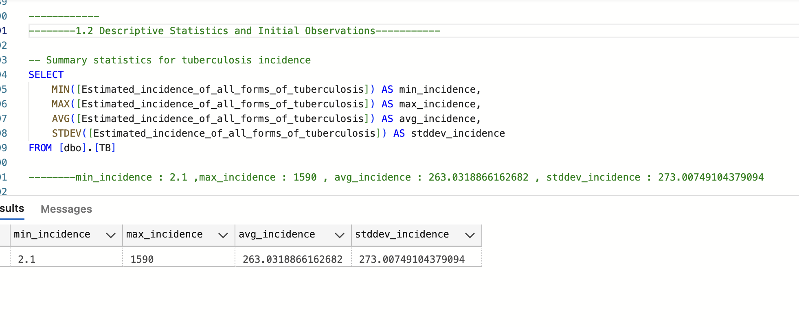
Descriptive Analysis
1.2 Descriptive Statistics and Initial Observations

Slide 6
Tuberculosis Incidence Statistics
Minimum Incidence (2.1)
Indicates effective TB control and possibly strong healthcare systems in certain regions or periods.
Maximum Incidence (1590)
Highlights regions or times with severe TB challenges, likely due to factors like poor healthcare infrastructure or high
HIV co-infection rates.
Average Incidence (263.03)
Represents the general TB burden across studied areas, useful for assessing global TB control efforts.
Standard Deviation (273.01)
Shows substantial variability in TB incidence, suggesting a need for region-specific health interventions.

Slide 7
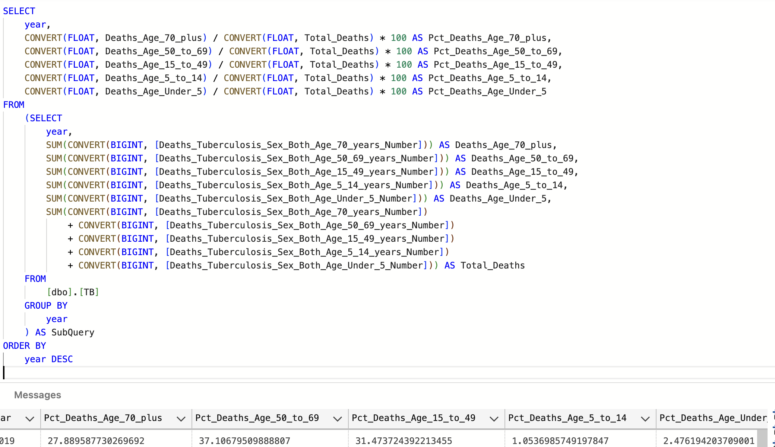
distribution of tuberculosis deaths by age group

Slide 8
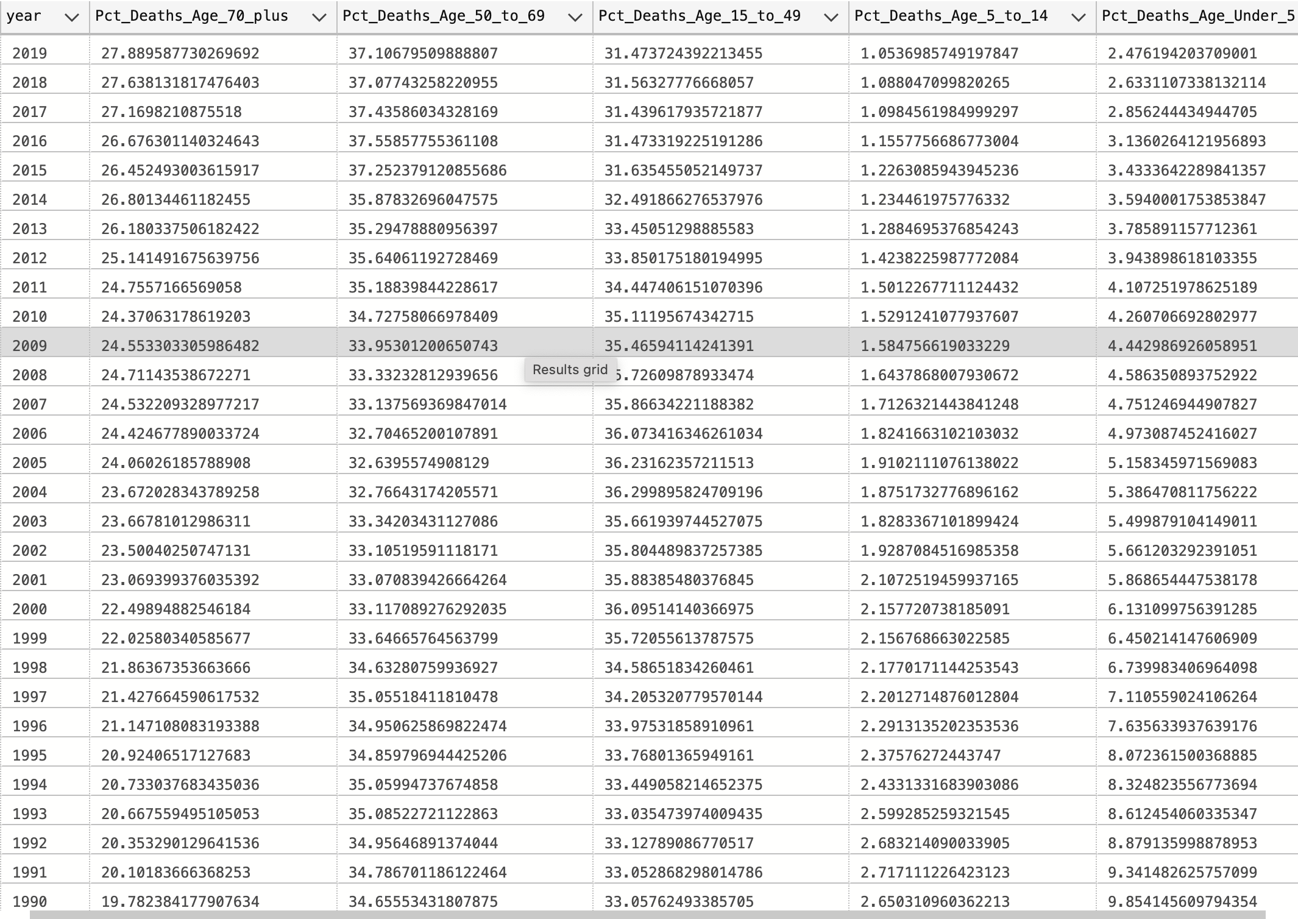

Slide 9

Least Affected Age Groups:
Under 5 Years: Rarely exceeds 5%.
Ages 5 to 14: Low impact, percentages around 1% to 5%.
Most Affected Age Groups:
Ages 50 to 69: Often above 30%, indicating high vulnerability.
Ages 70+: Frequently in the high 20s to 30s percent range.
These insights suggest targeted health interventions might be particularly necessary for the older age groups, while the resilience of younger populations should be further studied to understand protective factors or reporting discrepancies.

Slide 10
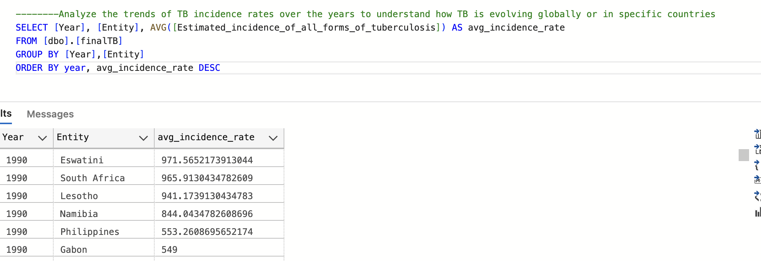
Descriptive Analysis
2.1 Regional Analysis of Tuberculosis Incidence

Slide 11
High Incidence Rates: The countries listed show relatively high TB incidence rates in 1990, particularly in southern Africa.
Eswatini (formerly Swaziland) and South Africa have the highest rates, nearing or exceeding 965 cases per 100,000 population. This highlights a significant health burden and suggests that TB was a major public health issue in these countries at the time.
Regional Impact: The data indicates a regional trend in southern Africa (Eswatini, South Africa, Lesotho, Namibia) where TB incidence rates are particularly high. This region may have faced specific socio-economic or healthcare-related challenges contributing to these high rates.
https://www.ncbi.nlm.nih.gov/pmc/articles/PMC7687760/

Slide 12
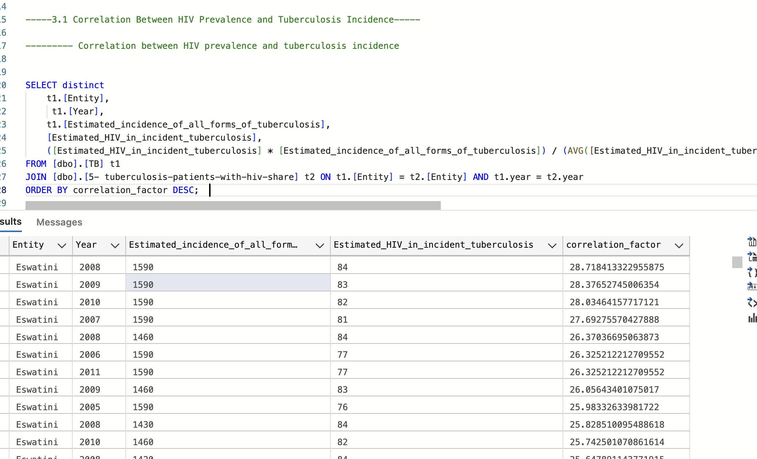
3. Comparative and Correlational Analysis
3.1 Correlation Between HIV Prevalence and Tuberculosis Incidence

Slide 13

HIV weakens the immune system, increasing the risk of TB in people with HIV.
Infection with both HIV and TB is called HIV/TB coinfection. Untreated latent TB infection is more likely to advance to TB disease in people with HIV than in people without HIV​
https://hivinfo.nih.gov/understanding-hiv/fact-sheets/hiv-and-tuberculosis-tb#:~:text=healthy%20immune%20systems.-,HIV%20weakens%20the%20immune%

Slide 14
· Persistent TB Burden: Eswatini consistently shows high TB incidence rates, indicating a severe ongoing challenge.
· Significant HIV Prevalence: HIV prevalence among TB patients remains high, reinforcing the link between TB and HIV infections.
· Strong Correlation: Correlation factors above 25 indicate a robust positive association between HIV prevalence and TB incidence, emphasizing the impact of HIV on TB dynamics.
· Stable Yearly Trends: Despite yearly variations in data, the correlation between HIV and TB remains strong, highlighting their interdependence.
· Public Health Strategy: The data supports integrated public health approaches to effectively manage both HIV and TB in Eswatini.

Slide 15
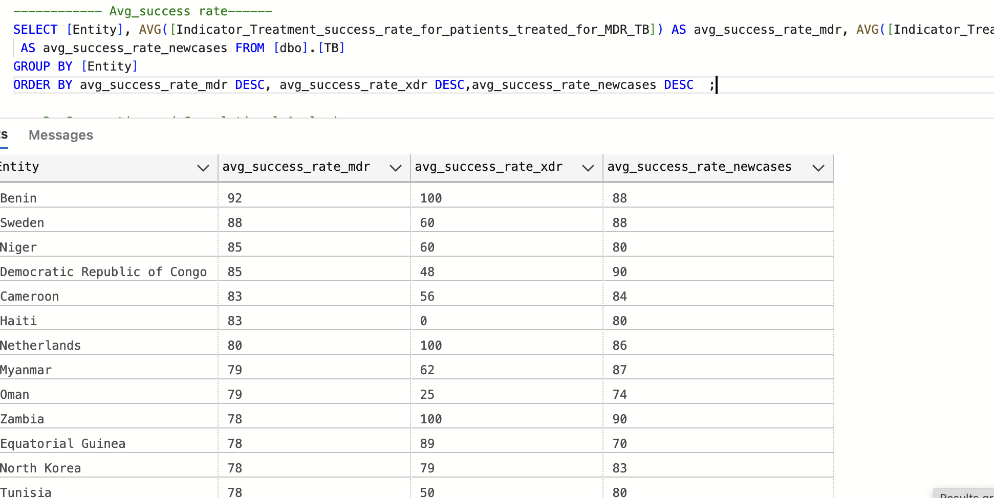
3.2 Treatment Success Rate Comparison

Slide 16
High MDR TB Treatment Success: Benin and Sweden excel in MDR TB treatment, with Benin achieving a 100% success rate, indicating effective management strategies.
Variable XDR TB Success Rates: Significant variation exists in XDR TB treatment success, with Sweden at 60% and Haiti at 0%, reflecting disparities in treatment capabilities.
Effective New TB Case Management: Countries like Benin lead with high success rates (88%) for new TB cases, showcasing strong initial treatment protocols.
Challenges with Resistant TB: Countries such as Oman and Myanmar display lower success rates for resistant TB, underscoring the need for enhanced management approaches.
Call for Targeted Interventions: The data highlights the need for specific health interventions to improve outcomes, particularly in countries with lower success rates for resistant TB.
These insights can guide improvements in global TB management, particularly for resistant strains.

Slide 17
Predictive Modeling and Classification Using Weka

Slide 18
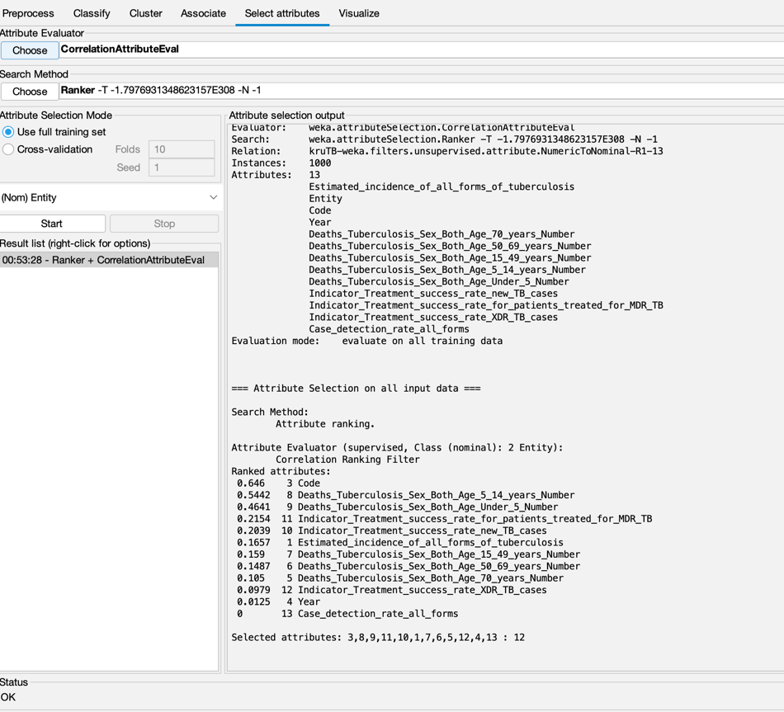
CorrelationAttributeEval with a Ranker search method.

Slide 19
• Attributes Evaluated: 13 attributes related to tuberculosis statistics were evaluated. The top three attributes with the highest correlation to the target variable ("Entity") are:
Country Code: (0.64)
Deaths_Tuberculosis_Sex_Both_Age_Under_5-14Number (0.542)
Indicator_Treatment_success_rate_for_patients_treated_for_MDR_TB
(0.441)
These selected attributes are likely key predictors in understanding or modeling tuberculosis outcomes, which can enhance model performance and interpretability.

Slide 20
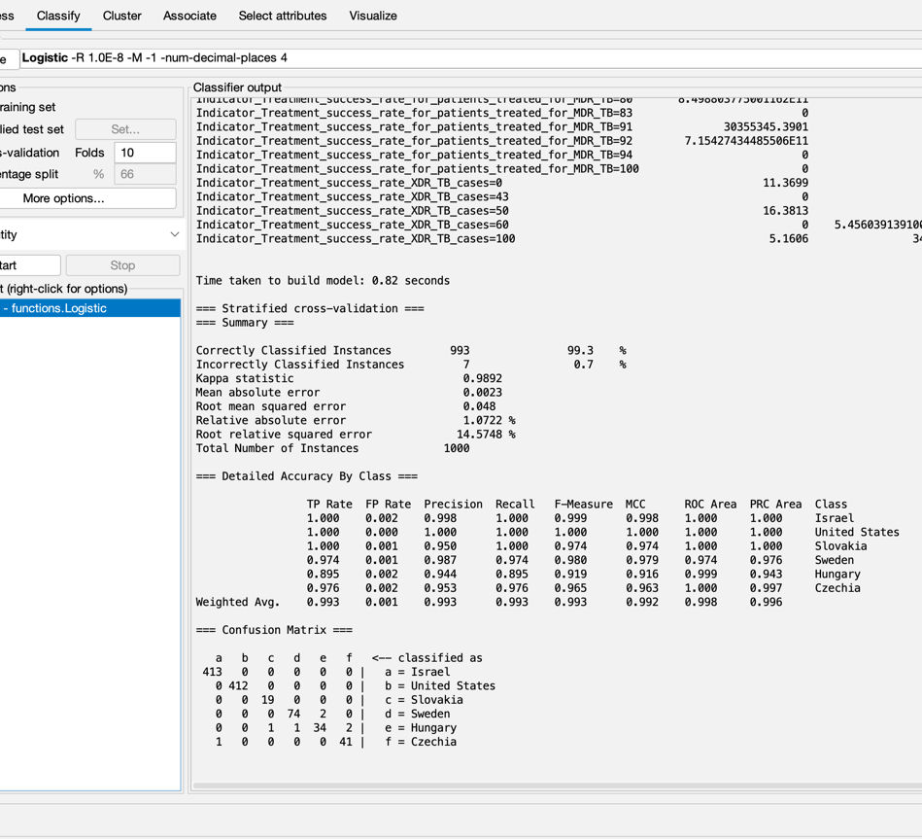
2.Model Training:
Cross-validation: Use cross-validation (e.g., 10-fold) to evaluate model performance on the training set.

Slide 21
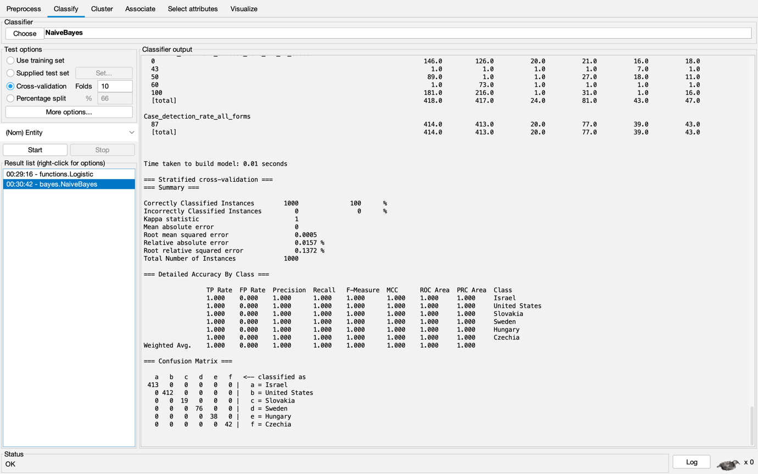

Slide 22
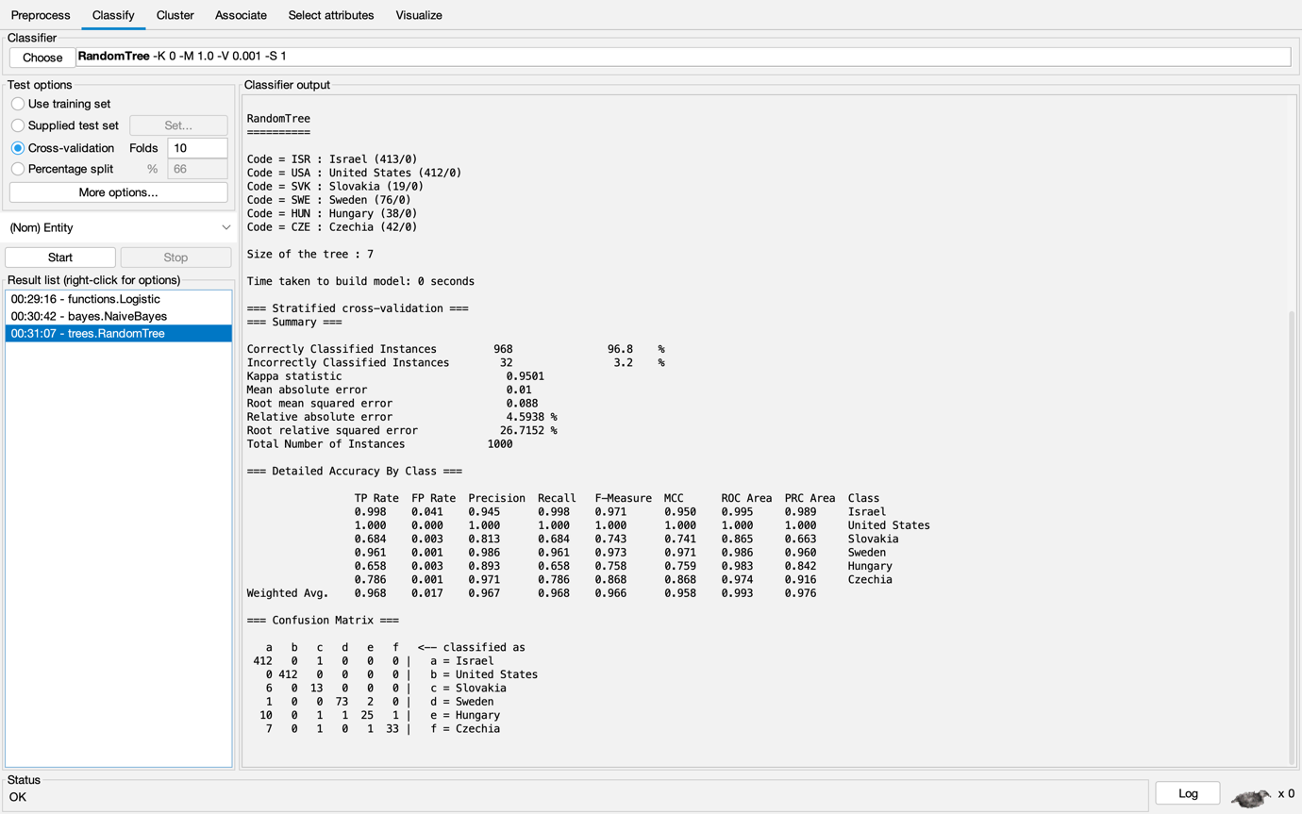

Slide 23
*All three models perform exceptionally well, with accuracies above 96%.
*Naive Bayes achieves perfect classification on this dataset, suggesting the features are highly indicative of the classes and likely follow the independence assumption of Naive Bayes.
*Logistic Regression comes very close to perfect classification, with only minor misclassifications.
*The Random Tree model, while still performing well, shows slightly lower accuracy and precision compared to the other two, possibly due to some overfitting or the nature of the decision boundaries in the data.
*For all models, certain classes (like Israel and United States) consistently achieve perfect precision, indicating these are the easiest to distinguish.
The high performance showed by Bayes Net suggests that the dataset has well-separated classes and strong predictive features.

Slide 24
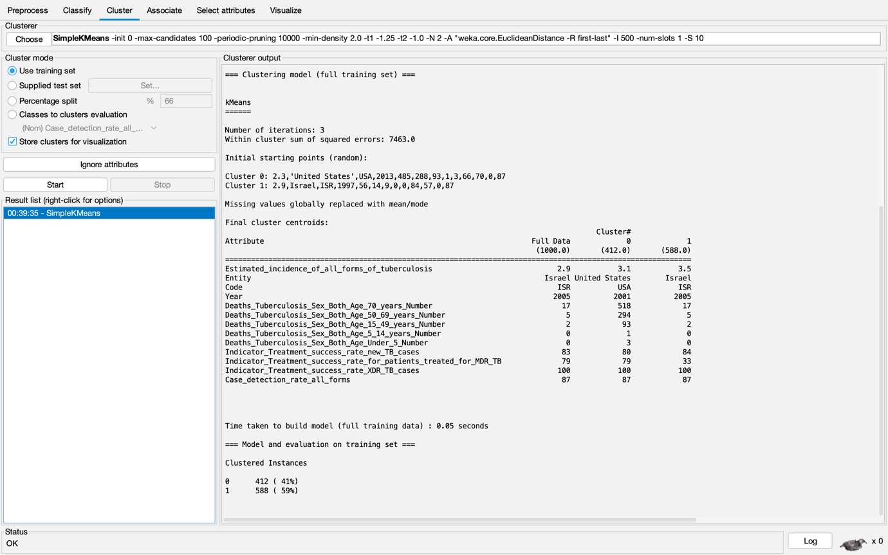

Slide 25
The model created 2 clusters:
Cluster 0: 412 instances (41% of data)
Cluster 1: 588 instances (59% of data)
Key Insights
Cluster 0:
TB Incidence: Lower average rate (2.9)
Mortality: Higher in 50-69 age group; moderate in 15-49; very low in other age groups
Treatment Success: High for MDR (79%) and XDR TB (100%)
Cluster 1:
TB Incidence: Higher average rate (3.5)
Mortality: Higher in 50-69 age group; slightly higher in younger (15-49) and older (70+) groups
Treatment Success: High for MDR (79%) and XDR TB (100%)

Slide 26

Global Trends and High-Risk Regions: Southern Africa, particularly Eswatini and South Africa, shows high TB incidence rates, indicating the need for targeted interventions.
Age-Specific Vulnerabilities: Older populations (50-69 and 70+) are most affected by TB, while mortality rates are much lower in younger age groups. This highlights the need for age-specific interventions.
Impact of HIV on TB: A strong correlation between HIV prevalence and TB incidence underscores the need for integrated healthcare strategies to address both conditions.
Treatment Success Rates: Success rates vary widely, particularly for MDR and XDR TB. High-performing countries like Benin contrast with others that struggle, suggesting a need for better treatment protocols.
Predictive Modeling: Accurate models, such as BayesNet, are effective in forecasting TB trends and can aid in public health planning to prevent future outbreaks.

Slide 27

Regional Prioritization: Focus efforts on high-incidence regions, particularly in southern Africa, to curb the spread of TB.
Targeted Interventions: Develop age-specific interventions, particularly for older populations, who are most vulnerable to TB mortality.
Integrated Health Strategies: Implement combined TB and HIV programs, especially in high HIV-prevalence regions, to address the synergistic impact of these diseases.
Strengthening Treatment Protocols: Invest in improving treatment protocols and access to care, especially in regions struggling with drug-resistant TB strains.
Utilizing Predictive Models: Leverage predictive modeling to guide future public health interventions and optimize resource allocation.

Slide 28


Thank you

